Slide 1
Shoe Aid in Schools

Slide 2
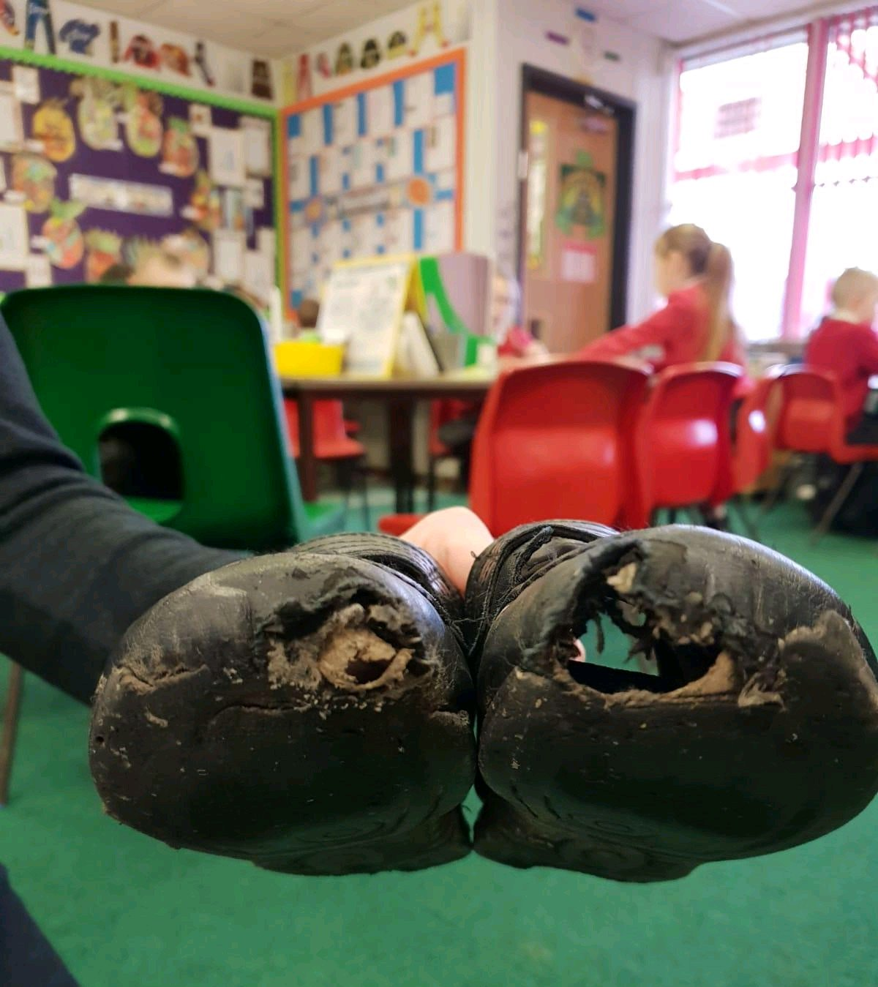
The Problem
Currently in the UK
4 million children are wearing the wrong size/inadequate shoes which causes
Physical problems in later life
Bullying
Isolation and low self esteem

Slide 3
The Problem
200,000 homeless & those below the poverty line do not have adequate footwear which causes
Trench foot
Prevents them from attending job interviews and gaining employment
Isolation and low self esteem

Slide 4
The Problem
2 Million shoes are wasted each week which causes
Landfills being overwhelmed with shoe waste
Damage to the environment with shoes taking 100 years to bio degrade

Slide 5
The Solution?
We source and supply free footwear through our collection and distribution network throughout the UK and worldwide
We ensure that no child or adult has to go without Shoes in 2019 and beyond!

Slide 6
More about Shoe Aid
Talk about the bins, initiatives with celebrities, football clubs etc. use more than one slide for this

Slide 7
More about Shoe Aid
Talk about the bins, initiatives with celebrities, football clubs etc. use more than one slide for this

Slide 8
Support from Teachers
Select and support school ambassadors in either primary, secondary or further education
Manage the “Future Shoe” and “Promo-Shoe” workshops and competitions (either at a whole school or extra curricular level)

Slide 9
Why be a School Ambassador?
Help people and children who really need it
Develop a huge number of skills including team work, organisational and business skills
Excellent experience to add to your CV to show your philanthropic personality and skills

Slide 10
Shoe Aid Workshops and Collaborations
There are two school competitions created for Shoe Aid by Siddiqui Education with prizes Sponsored by Start Rite
These not only raise awareness of the shoe problem in the UK but also develop the pupil's transferable skills

Slide 11
Future Shoe
Target Audience – Primary and early years secondary school children
Students work in groups of three & use Start Rites advanced development model to design a shoe for the future

Slide 12
Promo Shoe
Target Audience – Secondary School Children and FE.
Students work in groups of three & use facts and figures from Shoe Aid’s website to create an animation or video to promote Shoe Aid and raise awareness of the footwear issue in the UK

Slide 13
Workshop Benefits
Both Promo Shoe and Future Shoe have been created by experienced teachers who aim to develop students:
Creativity
Team work
Research skills
Planning skills
Communication and presentation skills
Digital literacy skills

Slide 14
Competition
All schools involved in both workshops will be able to submit their ideas to Shoe Aid
The best Shoe Design and Promotion will win prizes courtesy of Start Rite

Slide 15
Get Involved
Visit www.shoeaid.co.uk to:
Find out more about our mission and lend your support through donations
Download the “Promo Shoe” and “Future Shoe” resources (Launching September 2019)

